Slide 1
Business and Culture in Russia &Eastern Europe

Slide 2
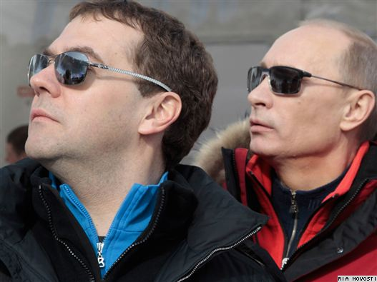
Business in Russia and Eastern Europe
Democracy vs. Kleptocracy
Putin ~ Medvedev ~ Putin
Politics of Oil & Gas

Slide 3
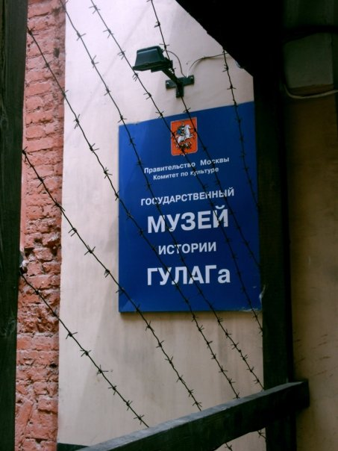
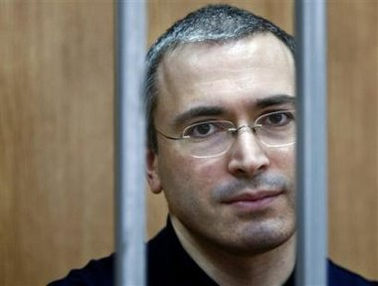
Ethics & Corruption
Ethics
Friends vs. foes
What’s ours is…mine
“Corruption Fatigue”
Red Tape, Police, Customs, etc.
Gray market
Cash business
“Illegal” software

Slide 4
Спасибо!
csees@osu.edu

