Slide 1
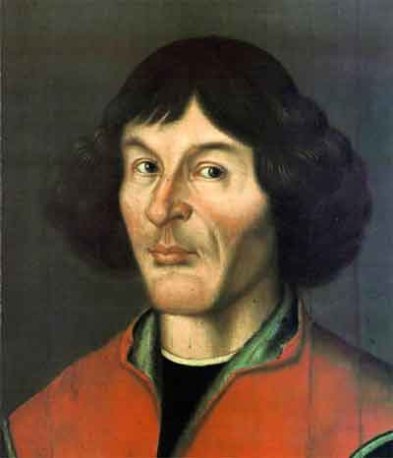
Nicolaus Copernicus
1473–1543

Slide 2
Early Life
Nicolaus Copernicus was born on 19 February 1473 in Torun, Poland
His family was ethnically German
When his parents died, his uncle cared for him and his siblings, and he later proved to be influential on his studies and eventual career in the church

Slide 3
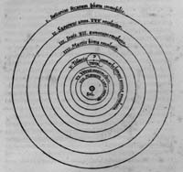
Accomplishments and Contributions
Copernicus was known as a capable mathematician
His theories on how the planets revolve around the sun, termed a heliocentric system influenced our understanding of how our universe is arranged
When he first introduced the idea, many of his contemporaries disagreed with him.
Copernicus’s model of the planets – Note that the Sun is in the center
Source: http://www.hps.cam.ac.uk/starry/copernicus.html

