Slide 1
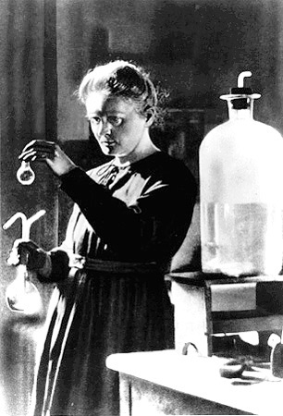
Marie curie
1867-1934

Slide 2
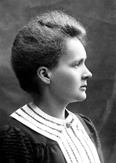
Early life
Marie Curie was born Maria Sklodowska, in Warsaw, Poland on November 7, 1867
She was the daughter of a secondary school teacher, who taught her basics of science
She eventually left Poland because she was involved in student revolutionary activities
In 1891, she went to Paris where she studied at the Sorbonne where she studied Physics and Mathematical Sciences.

Slide 3
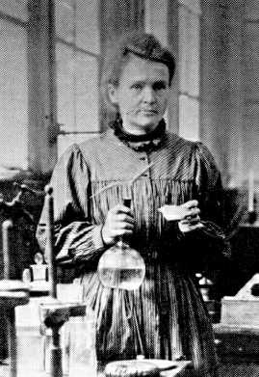
Scientific Accomplishments
Marie Curie’s work was very important to the scientific community
She received many honorary science, medicine and law degrees and honorary memberships of learned societies throughout the world.
Together with her husband, she was awarded half of the Nobel Prize for Physics in 1903
In 1911 she received a second Nobel Prize in Chemistry, in recognition of her work in radioactivity

