Slide 1
Polish
Język polski
Rebecca Dulemba Spring 2010
Notes:
“Język polski” means “the Polish language” in Polish and is pronounced “yen-zik pole-ski”

Slide 2
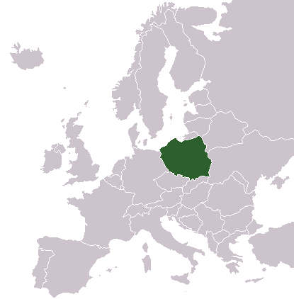
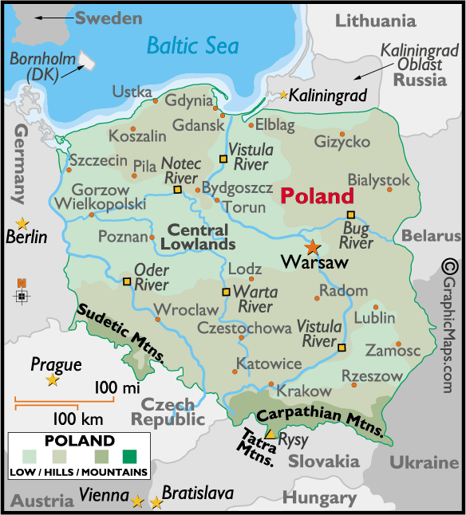
Poland
Center for Slavic and East European Studies at Ohio State University
Notes:
Poland is a Central European country about the size of New Mexico
Neighbors include: Germany, the Czech Republic, Slovakia, Ukraine, Belarus, Lithuania, and Russia
Polish is the official language of Poland

Slide 3
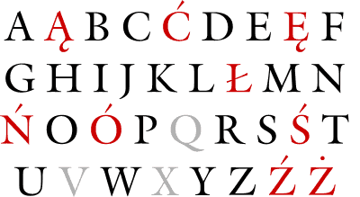
The Polish Alphabet
Center for Slavic and East European Studies at Ohio State University
GRAY letters are letters used in English, but not in Polish
RED letters are letters used in Polish, but not in English
Notes:
Gray letters indicate those used in the English alphabet, but not in the Polish alphabet
Red letters indicates those used in the Polish alphabet, but not in the English alphabet
Thus, the Polish alphabet is comprised of the red and black letters
For links to a pronunciation guide, see the Additional Resources slide

Slide 4
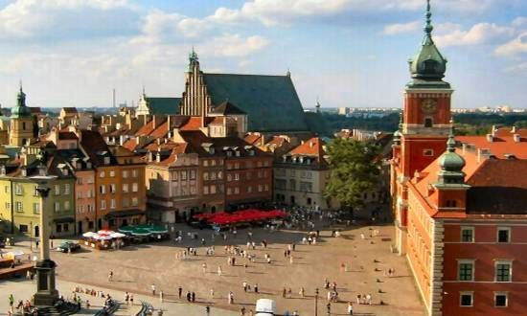
Hello!
Center for Slavic and East European Studies at Ohio State University
Hello!
(formal, to a teacher or adult):
Dzien dobry !
Jin dobe-ree
The Old Town Square in Warsaw, the capital of Poland
Dzien dobry!
Notes:
In Polish, as in many other foreign languages, you speak to authority figures (or strangers) differently than you do with friends & family (there are 2 registers: formal and informal)

Slide 5
Dialog (formal)
Center for Slavic and East European Studies at Ohio State University
Dzien dobry!
Mam na imię Pan Smith.
Miło mi!
Do widzenia!
A dialogue between a child and an adult:
Dzien dobry!
Mam na imię Alex.
Jak ma Pan na imię?
Miło mi Pana poznać!
Do widzenia!
Notes:
“Dialog” (dee-ah-log) is Polish for “dialogue”

Slide 6
Center for Slavic and East European Studies at Ohio State University
Kubuś Puchatek
Winnie the Pooh
English
Polish
Edward Bear, known to his
friends as Winnie-the-Pooh, or
Pooh for short, was walking
through the forest one day,
humming proudly to himself.
He had made up a little hum that
very morning, as he was doing
his Stoutness Exercises in front of
the glass.
Pewnego pięknego dnia Miś,
zwany przez swych przyjaciół
Kubusiem Puchatkiem albo
krócej Puchatkiem, przechadzał
się po Lesie, pomrukując dumnie
pod nosem. Tego dnia właśnie ułożył sobie małą
piosenkę, gdy wczesnym rankiem robił przed
lustrem swoje codzienne ćwiczenia
gimnastyczne na schudnięcie.
Notes:
Kubuś Puchatek (koo-boosh pooh-ahtek) is Polish for Winnie the Pooh; literally, Kubuś Puchatek means “Pooh Bear”
An excerpt of A. A. Milne’s “Winnie the Pooh” is provided so that students can gain a sense of what the Polish language looks like

