Slide 1
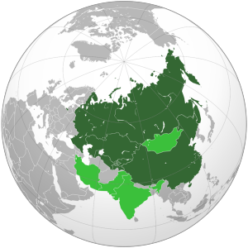
Shanghai Cooperation Organization
The Stakes for Russia

Slide 2
Origins of SCO: Shanghai Five 1996
Demarcation of borders
Demilitarization of borders
Unified front against transnational separatist movements
Forum for economic cooperation
Aug. 1999: Declaration of “three evils”
Terrorism, Separatism, Religious Extremism

Slide 3
Founding SCO
June 2001 (before 9/11 and before US military presence in Central Asia)
Addition of Uzbekistan
2002 Official Charter signed in St. Petersburg
“Three Evils” incorporated into founding documents
Regional Anti-Terrorism Structure (RATS) established in Tashkent

Slide 4
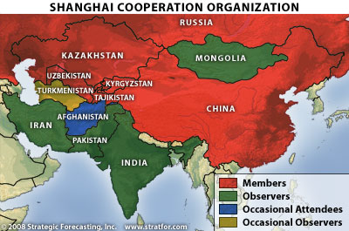

Slide 5
Andijan
May 13, 2005 Uzbek forces clash with protesters/insurgents, killing hundreds
US and EU call for investigation into events
SCO reaction
June 2005 Astana summit calls for withdrawal of Western forces from Central Asia
Uzbekistan demands closure of US Karshi-Khanabad (K-2) airbase and joins CSTO a year later
Realigning of Uzbekistan with Russia

Slide 6
Russian View on SCO Future
Against SCO enlargement
Limited economic integration with China while stressing SCO security functions (RATS)
Becoming symbol of stability contrasted with US-led instability on SCO southern rim
Russia as bridge between Asia and Europe

