Slide 1
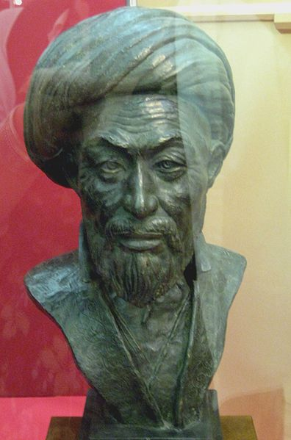
Ulugh Beg 1393-1449
Reproduction of Ulugh Beg’s visage

Slide 2
Background Details
Ulugh Beg was born in modern-day Iran to an Uzbek family
His nickname, Ulugh Beg, means “great ruler”
His real name was Mirza Mohammad Tāregh bin Shāhrokh
He was the grandson of a great conqueror and his mother was a noble woman
He is known for his capable leadership and contributions to math and astronomy

Slide 3
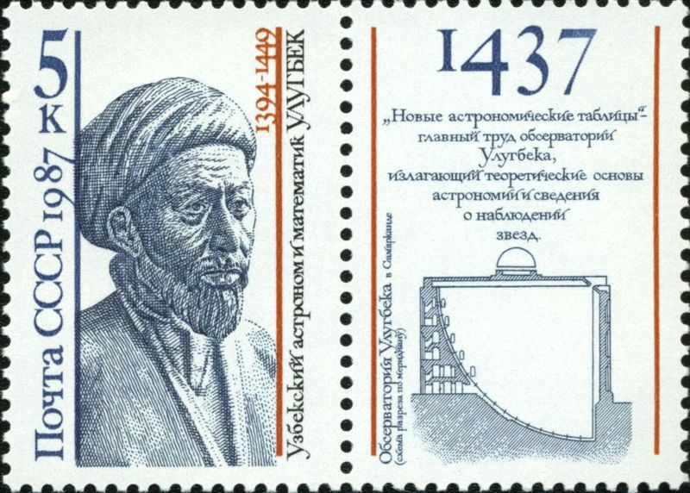
Contributions to Astronomy
By working in his observatory, Ulugh Beg cataloged 994 stars in his work Zij-i-Sultani in 1437
The catalog of stars was quite important and was used by other astronomers until the 17th century.
He determined that a year has 365 days
He also determined the tilt of the Earth, which remains the most accurate to this day
Soviet Stamp commemorating 550 years of Ulugh Beg’s observatory

